Slide 1
Jenkins- Introduction

Slide 2
Jenkins is an open-source automation server widely used for continuous integration and continuous delivery (CI/CD) of software projects. It helps automate the process of building, testing, and deploying applications, enabling teams to deliver software more rapidly and efficiently. Jenkins is highly extensible through its vast ecosystem of plugins, allowing integration with various tools and technologies commonly used in software development.
Here's a brief overview of the key concepts and components of Jenkins:
Continuous Integration (CI): Jenkins facilitates CI by automatically building and testing code changes as they are committed to the version control system (e.g., Git). This helps identify and fix issues early in the development cycle.
Continuous Delivery/Deployment (CD): Jenkins supports CD by automating the deployment of successfully built and tested code to various environments, such as development, staging, and production. This streamlines the release process and ensures consistency across environments.
Jobs and Pipelines: In Jenkins, tasks are organized into jobs or pipelines. A job represents a single task, such as building a project or running tests, while a pipeline is a sequence of jobs that define the entire CI/CD process.
Build Triggers: Jenkins can be configured to trigger builds automatically based on various events, such as code commits, scheduled times, or external triggers from other systems.

Slide 3
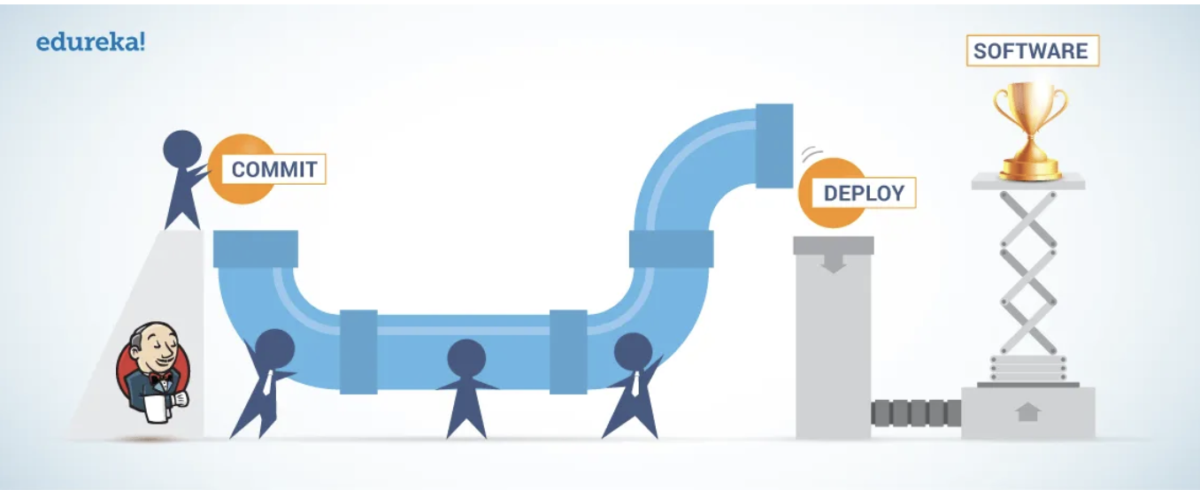

Plugins: Jenkins offers a vast repository of plugins that extend its functionality. These plugins cover a wide range of areas including source code management, build tools, testing frameworks, deployment, notifications, and more.
Distributed Builds: Jenkins supports distributed builds, allowing the workload to be distributed across multiple machines (called agents or nodes). This enables parallel execution of jobs and scalability for large projects.
Integration with Other Tools: Jenkins integrates seamlessly with other popular tools and services used in the software development lifecycle, such as version control systems (e.g., Git, SVN), build tools (e.g., Maven, Gradle), testing frameworks (e.g., JUnit), artifact repositories (e.g., Nexus, Artifactory), and deployment platforms (e.g., Kubernetes, Docker).

Slide 4

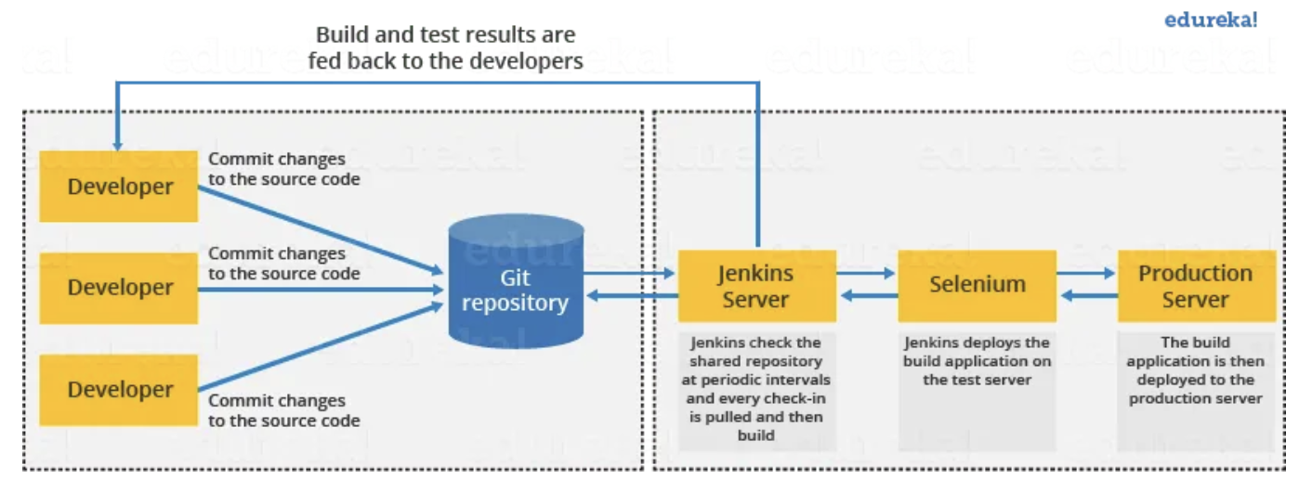
Architecture

Slide 5
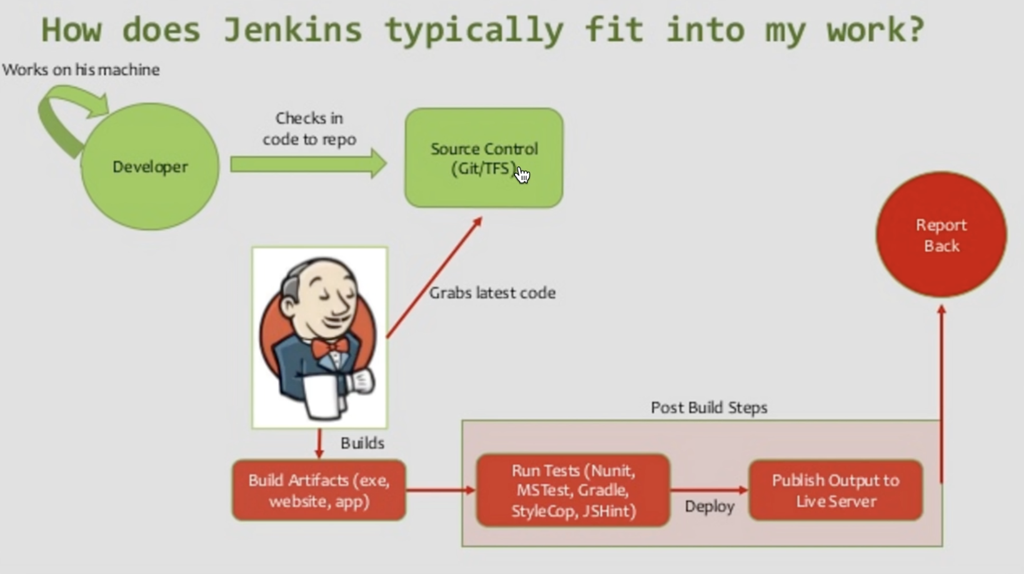

Slide 6
This single Jenkins server was not enough to meet certain requirements like:
Sometimes you might need several different environments to test your builds. This cannot be done by a single Jenkins server.
If larger and heavier projects get built on a regular basis then a single Jenkins server cannot simply handle the entire load.
To address the above-stated needs, Jenkins distributed architecture came into the picture.

Slide 7
Jenkins Distributed Architecture
Jenkins uses a Master-Slave architecture to manage distributed builds. In this architecture, Master and Slave communicate through TCP/IP protocol.
Jenkins Master
Your main Jenkins server is the Master. The Master’s job is to handle:
Scheduling build jobs.
Dispatching builds to the slaves for the actual execution.
Monitor the slaves (possibly taking them online and offline as required).
Recording and presenting the build results.
A Master instance of Jenkins can also execute build jobs directly.
Jenkins Slave
A Slave is a Java executable that runs on a remote machine. Following are the characteristics of Jenkins Slaves:
It hears requests from the Jenkins Master instance.
Slaves can run on a variety of operating systems.
The job of a Slave is to do as they are told to, which involves executing build jobs dispatched by the Master.
You can configure a project to always run on a particular Slave machine or a particular type of Slave machine, or simply let Jenkins pick the next available Slave.

Slide 8
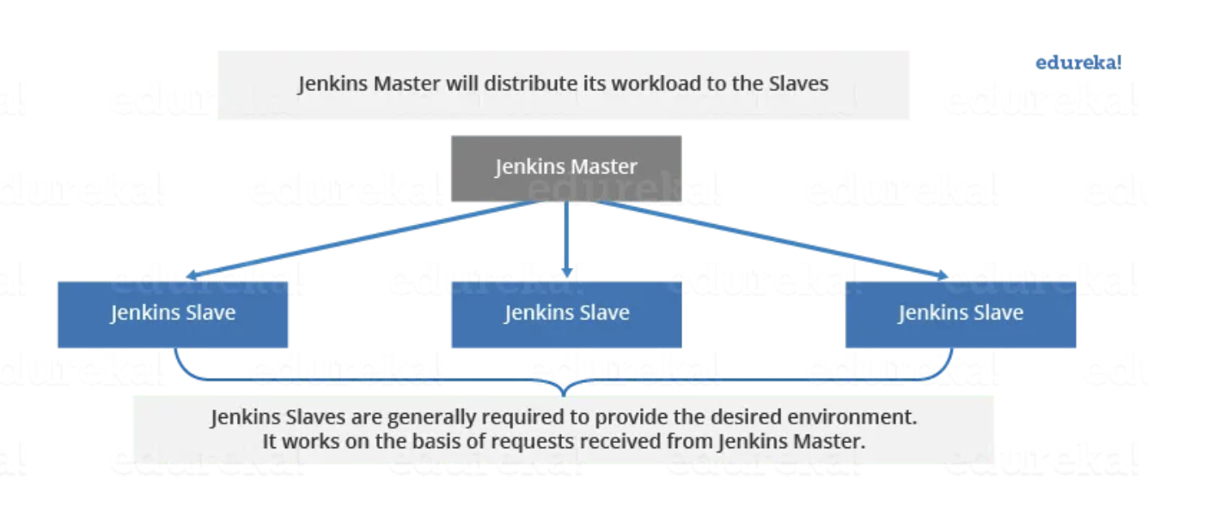

The diagram below is self-explanatory. It consists of a Jenkins Master which is managing three Jenkins Slave.

Slide 9
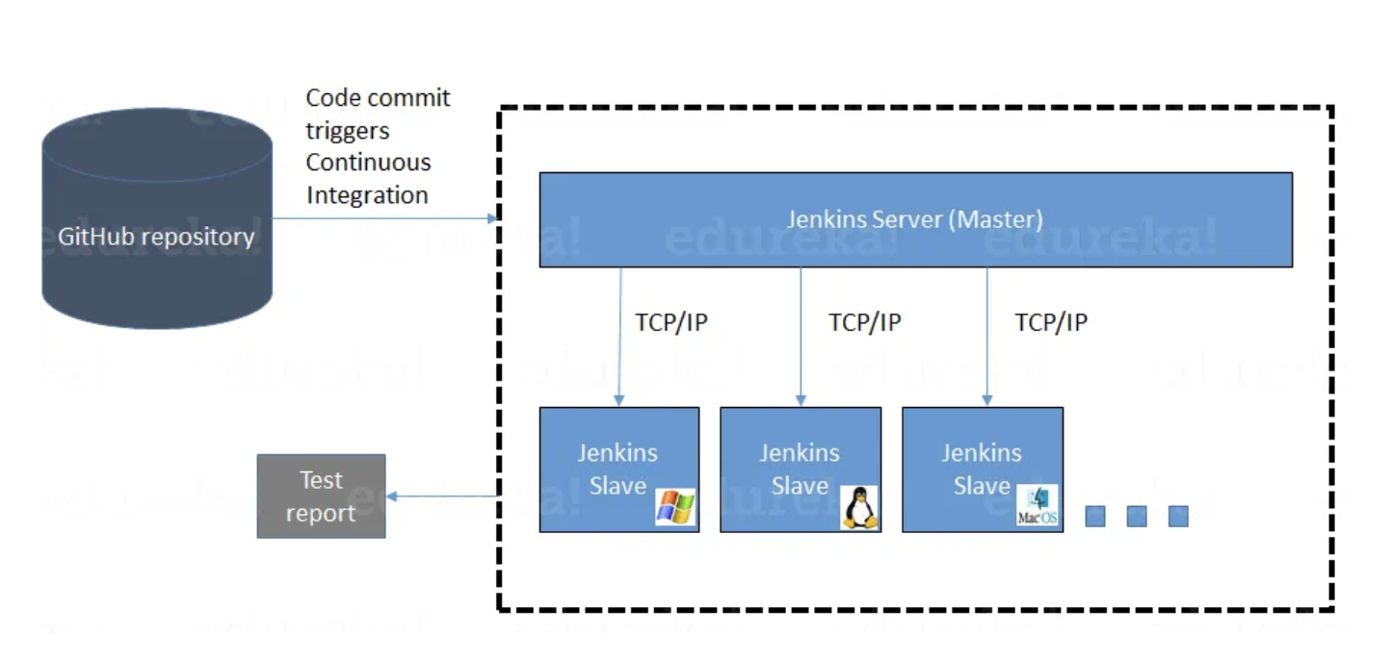
How Jenkins Master and Slave Architecture works?
Now let us look at an example in which we use Jenkins for testing in different environments like Ubuntu, MAC, Windows, etc.
The diagram below represents the same:

Slide 10
The previous slide image represents the following functions:
Jenkins checks the Git repository at periodic intervals for any changes made in the source code.
Each builds requires a different testing environment which is not possible for a single Jenkins server. In order to perform testing in different environments, Jenkins uses various Slaves as shown in the diagram.
Jenkins Master requests these Slaves to perform testing and to generate test reports.

Slide 11
Install Jenkins on Ubuntu EC2 machine:
Please follow the instruction here: https://github.com/muthuramanathanm/Jenkins-examples
create new repo
Clone the above repo (or) Copy all the files and commit and then push all the changes into new repo created
Check README doc and follow the instructions

Slide 12
How to change Home Directory:
cd /var/lib/jenkins
sudo service jenkins stop
sudo nano /etc/default/jenkins -> Add the following line to the file to set the JENKINS_HOME variable to the new directory path:
JENKINS_HOME="/new/path/to/jenkins/home"
sudo mkdir -p /new/path/to/jenkins/home
sudo chown -R jenkins:jenkins /new/path/to/jenkins/home
sudo mv /var/lib/jenkins/* /new/path/to/jenkins/home/
export JENKINS_HOME="/new/path/to/jenkins/home"
sudo service jenkins restart
ls -a /new/path/to/jenkins/home/

Slide 13
Create a new User:
Navigate to Jenkins and log in as a user with administrative privileges.
Click on "Manage Jenkins" from the dashboard.
Select "Manage Users" and then "Create User".
Fill in the user details such as username, password, full name, and email address.
Click "Create User" to add the user to Jenkins.

Slide 14
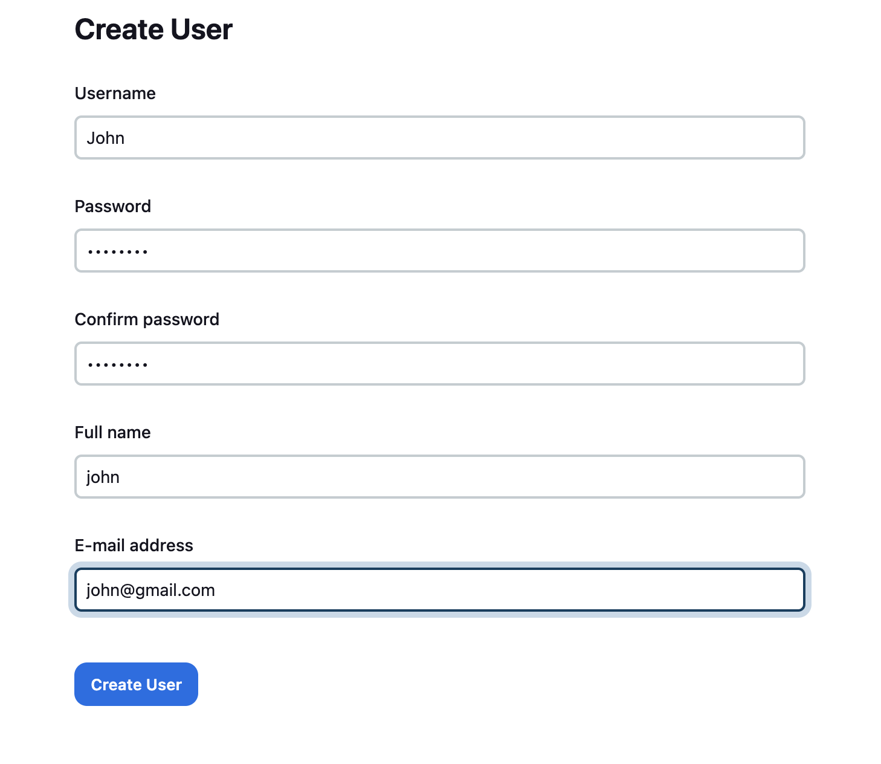
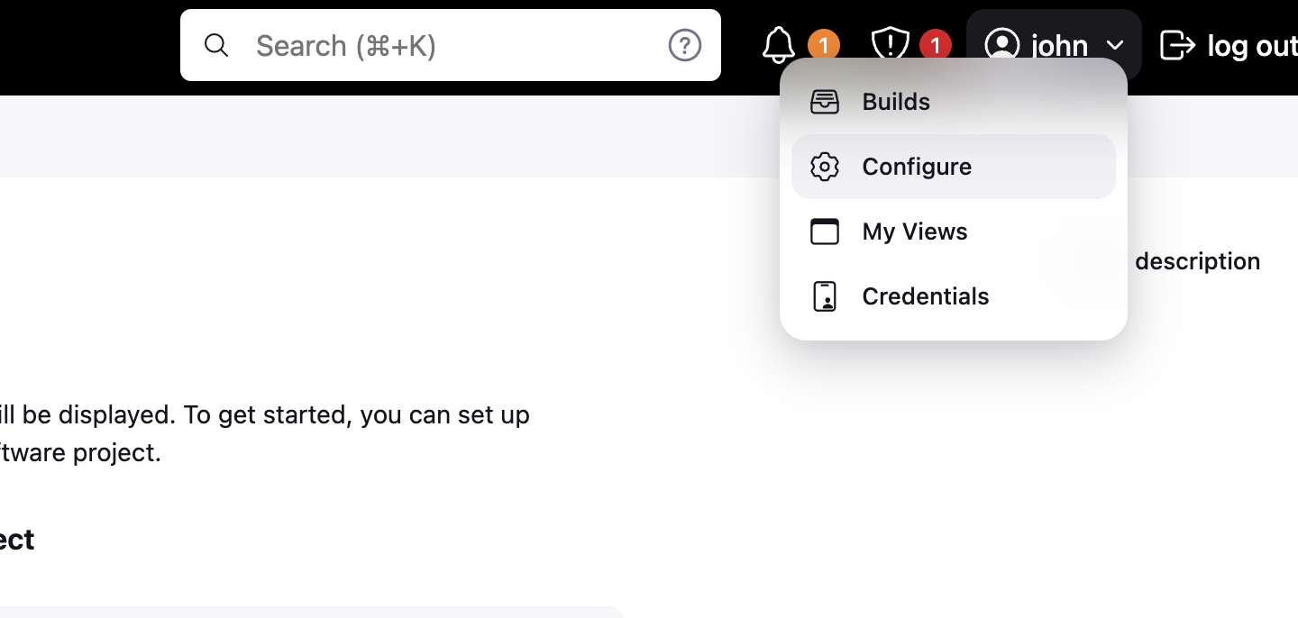
You can login using the user newly created

Slide 15
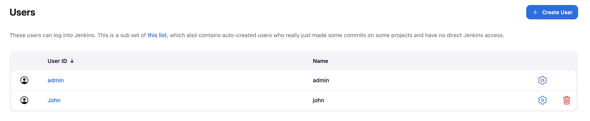
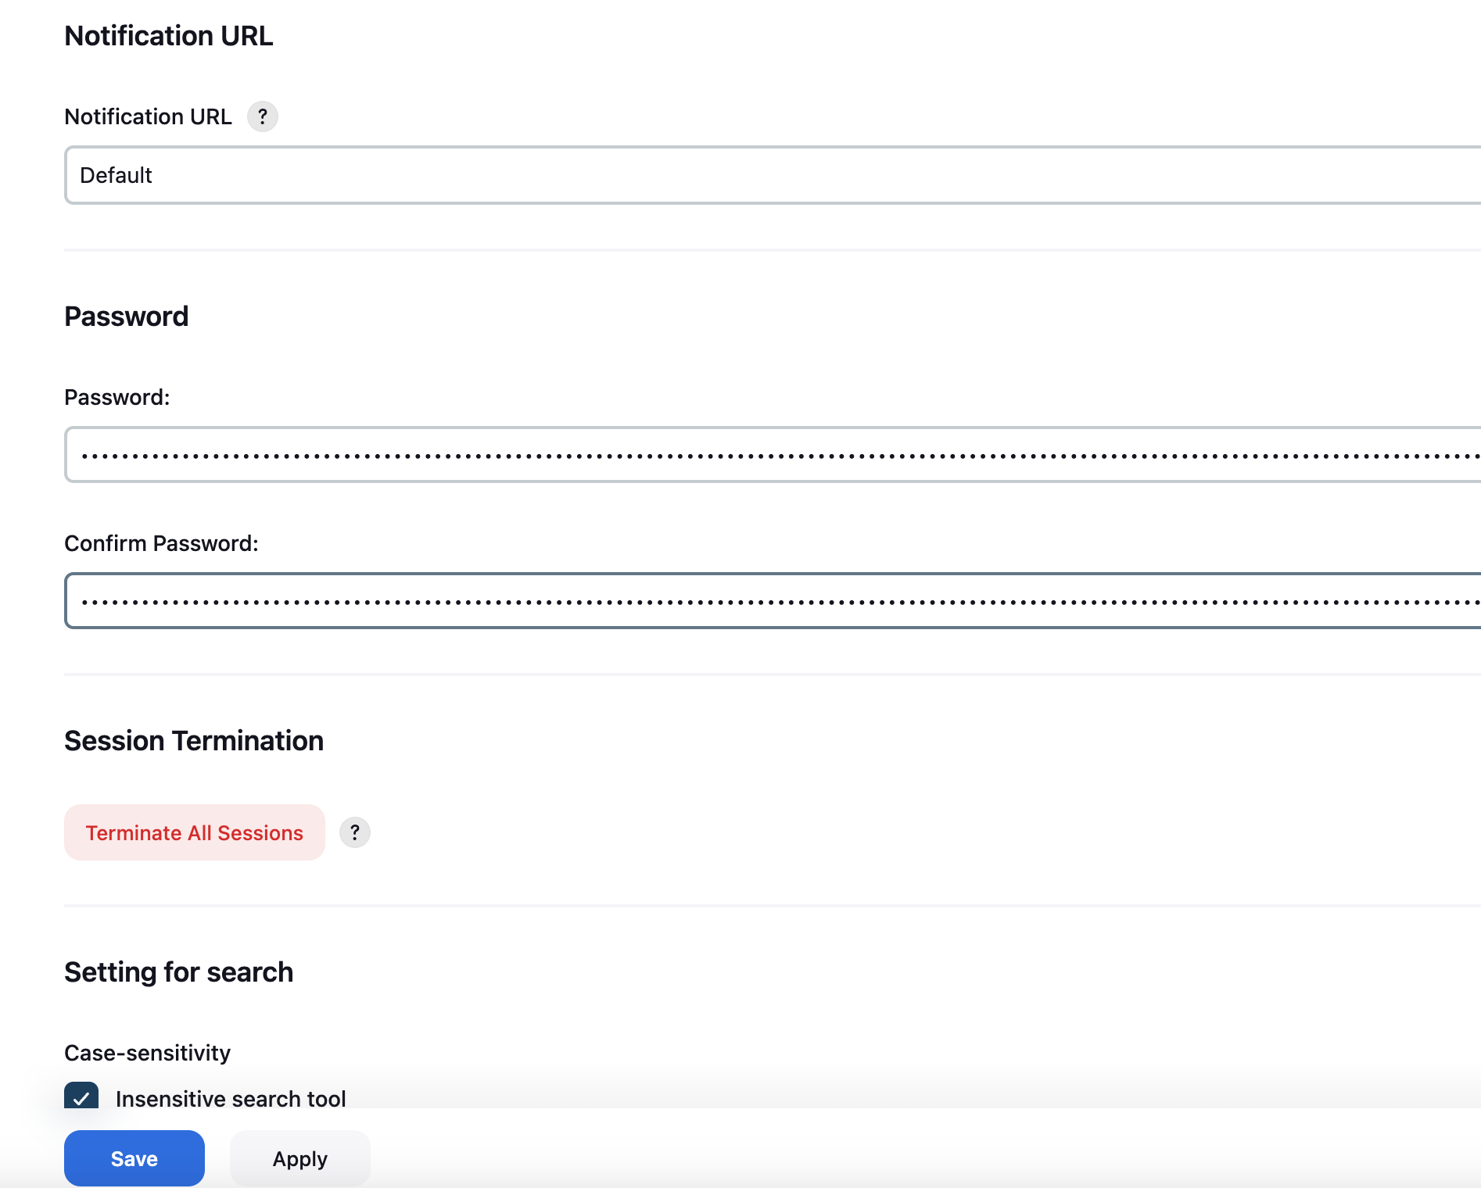
Manage user

Slide 16
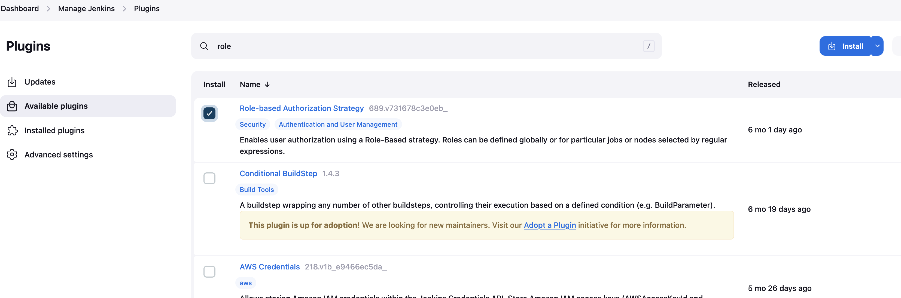
Create and manage user roles
Manage Plugins and choose available plugins.
Install Role-based authorization strategy (RBAC)

Slide 17
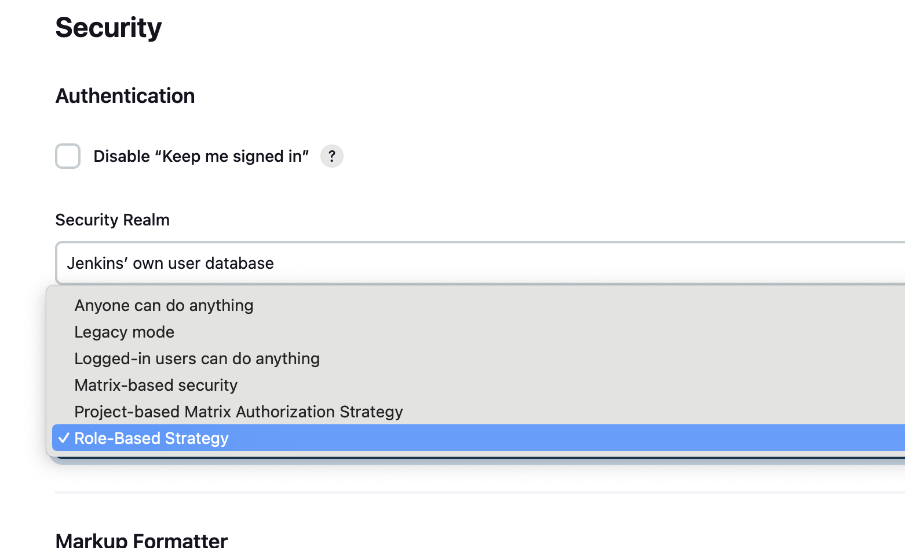
Login as admin and Go to manage Jenkins and select security option
Choose Role based strategy option from dropdown and save & apply

Slide 18
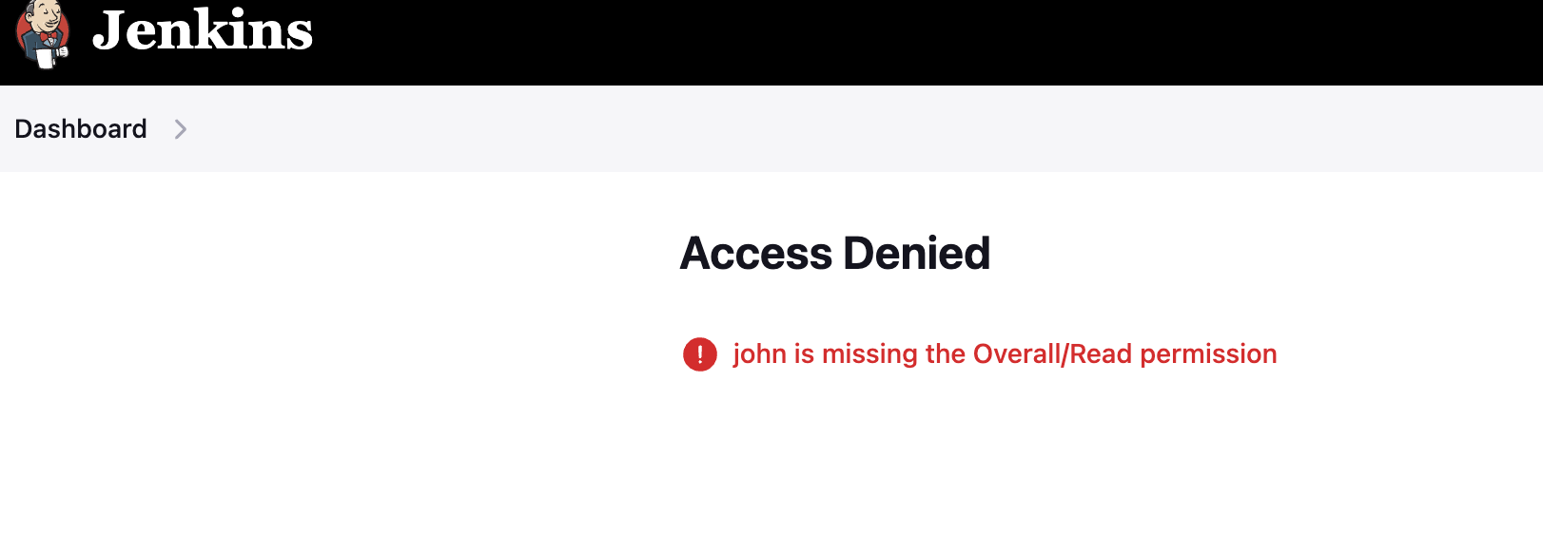
Now you can try to login as user created(John) and see the below error. Because Role based strategy does not allow

Slide 19
Authorization and Authentication
Login as admin user and go to manage Jenkins
Choose Manage and assign Roles
3 Types of Roles:
Global roles:
Global roles define permissions that apply globally across the entire Jenkins instance.
Users with global roles have permissions to perform actions that affect the entire Jenkins environment, such as managing global configurations, installing plugins, managing users, managing nodes, and configuring security settings.
Examples of global roles include administrators, system administrators, and global configuration administrators.

Slide 20
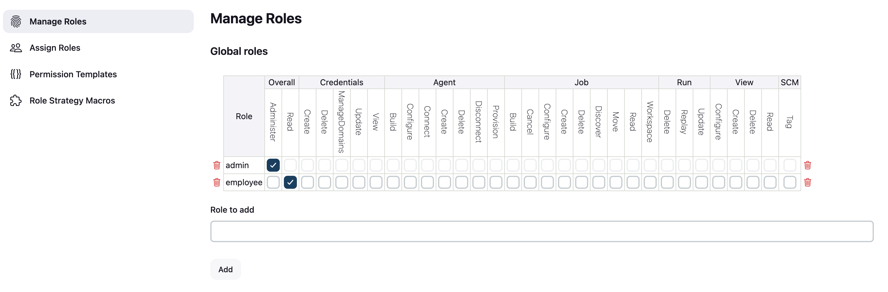
Add Employee to the Role and assign permission as below diagram
j
Item Role:
Item roles define permissions that apply to specific Jenkins items, such as jobs, folders, views, etc.
Users with item roles have permissions to perform actions related to specific items, such as creating, configuring, running, deleting, or viewing jobs or folders.

Slide 21
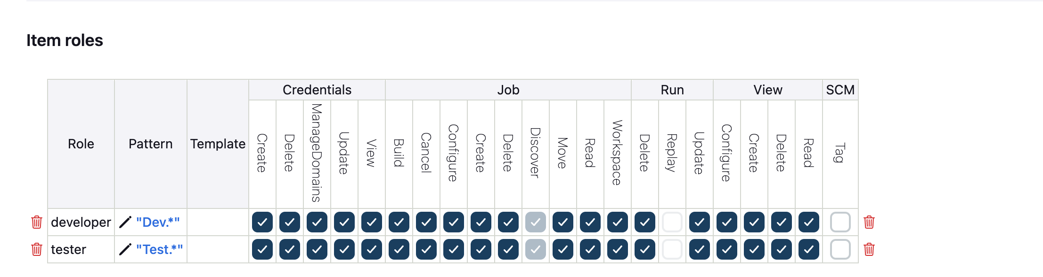
Create developer and tester as item role and assign permissions accordingly. Please refer below diagram

Slide 22
Agent roles:
Agent roles define permissions that apply to Jenkins agents (also known as nodes or slaves) that perform build and deployment tasks.
Users with agent roles have permissions to perform actions related to agents, such as configuring, launching, disconnecting, or deleting agents.
Agent roles allow for control over which users can interact with and manage Jenkins agents.
Examples of agent roles include agent administrators and agent operators

Slide 23
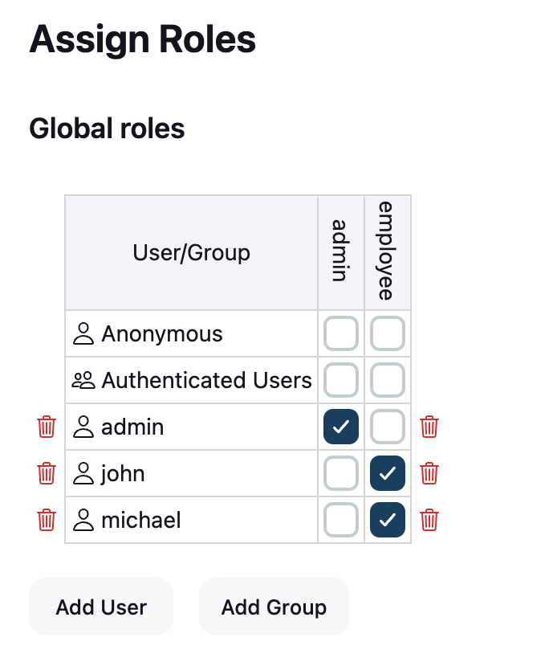
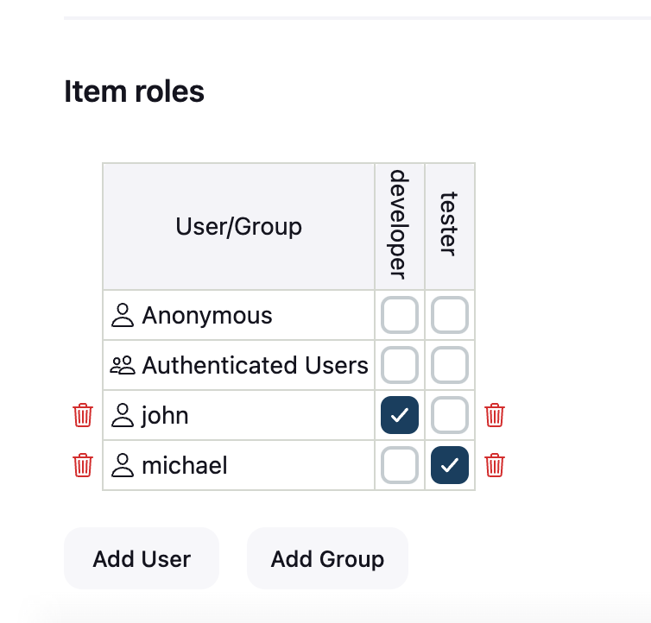
Go to Assign Role and assign the user to the role which we created

Slide 24
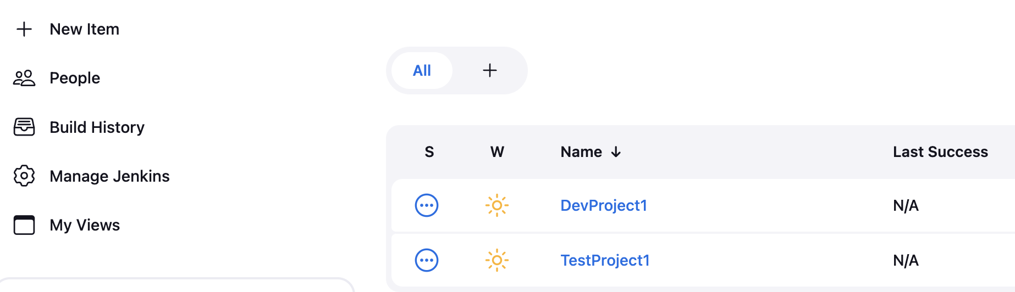
Now lets go and create 2 projects
Click on new Item and enter project -> DevProject1 -> save
Create another project -> TestProject1 -> save

Slide 25
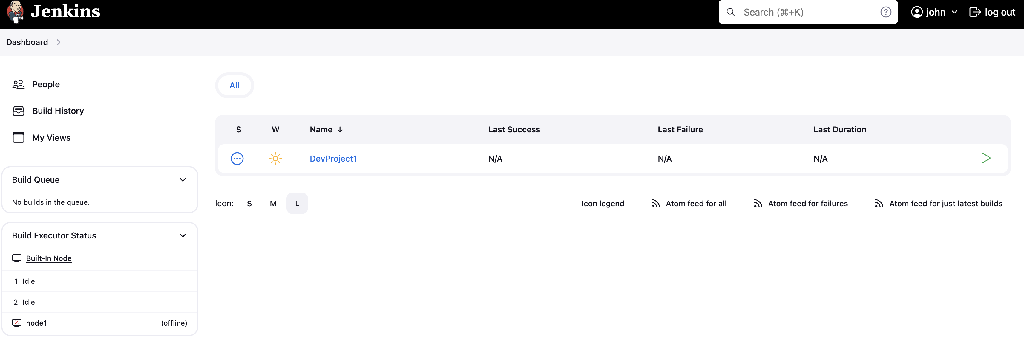
Validate the user login and verify:
Login as John user and see the Jenkins dashboard. “John” should see only DevProject1

Slide 26

Login as John user and see the Jenkins dashboard. “Mic” should see only Testproject1

